Slide 1





Innov8rs
TENET Hackathon
Smart Automated Nagrik-Sahayak
Team Members :-
Team Name | Innov8rs
Team Leader | Omkar Sunil Chavan
Member | Arpita Parmeshwar Gupta
Member | Yogesh Sanjay Dumane
Member | Kiran Ravindra Ingale
Github Repo Link –
https://github.com/teaminnov8rs/Smart-Automated-Nagrik-Sahayak

Slide 2
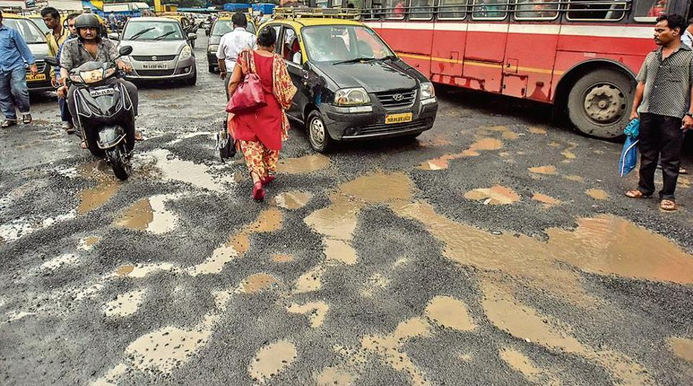

Innov8rs
Problem Statement
Addressing Urban Civic Issues
Problem:
Citizens face issues like potholes, garbage, or broken streetlights but avoid reporting as it takes too much time, they don’t know the right department, and portals differ across cities.
Solution:
An AI-powered app lets users simply click a photo. It detects the issue, finds the correct department from its database, and files the complaint automatically without manual effort.
Problem:
Many citizens are uncomfortable writing complaints, as they don’t know the proper format or the right language to use, leading to unclear or ignored submissions.
Solution:
AI generates clear and polite complaint letters in both English and regional languages, making them professional, standardized, and easy for authorities to act upon.
3.

Slide 3
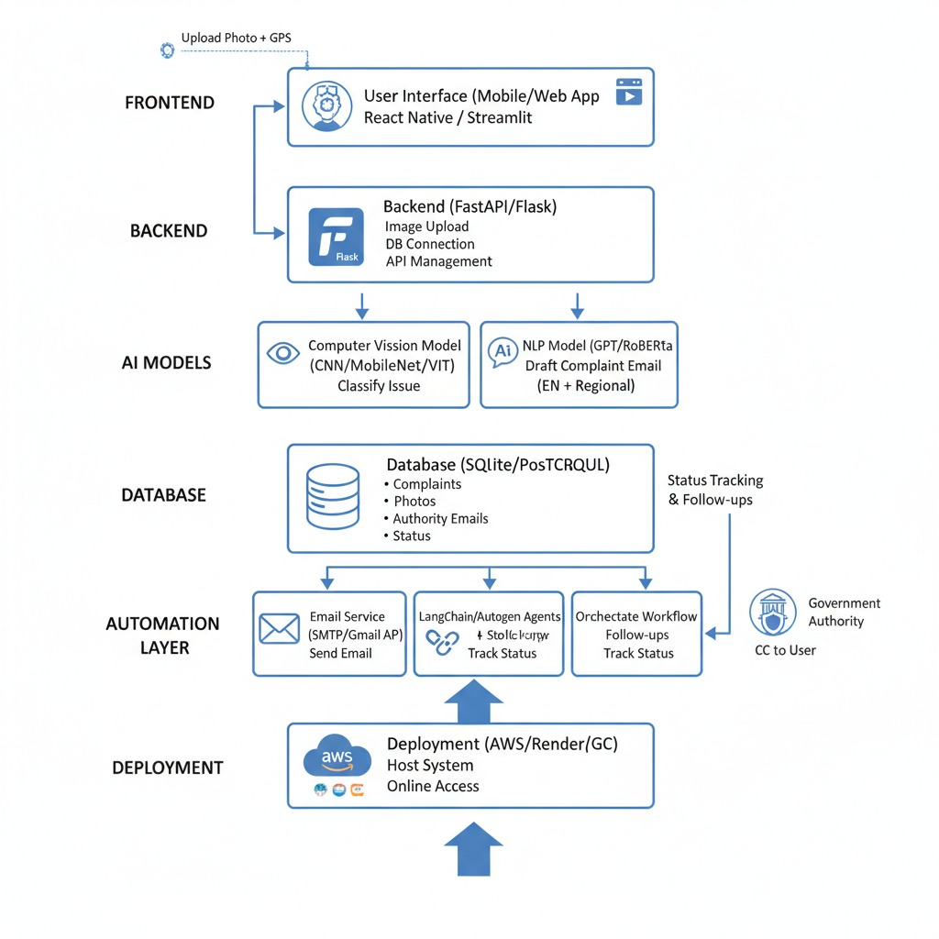

Innov8rs
Architecture Diagram

Slide 4
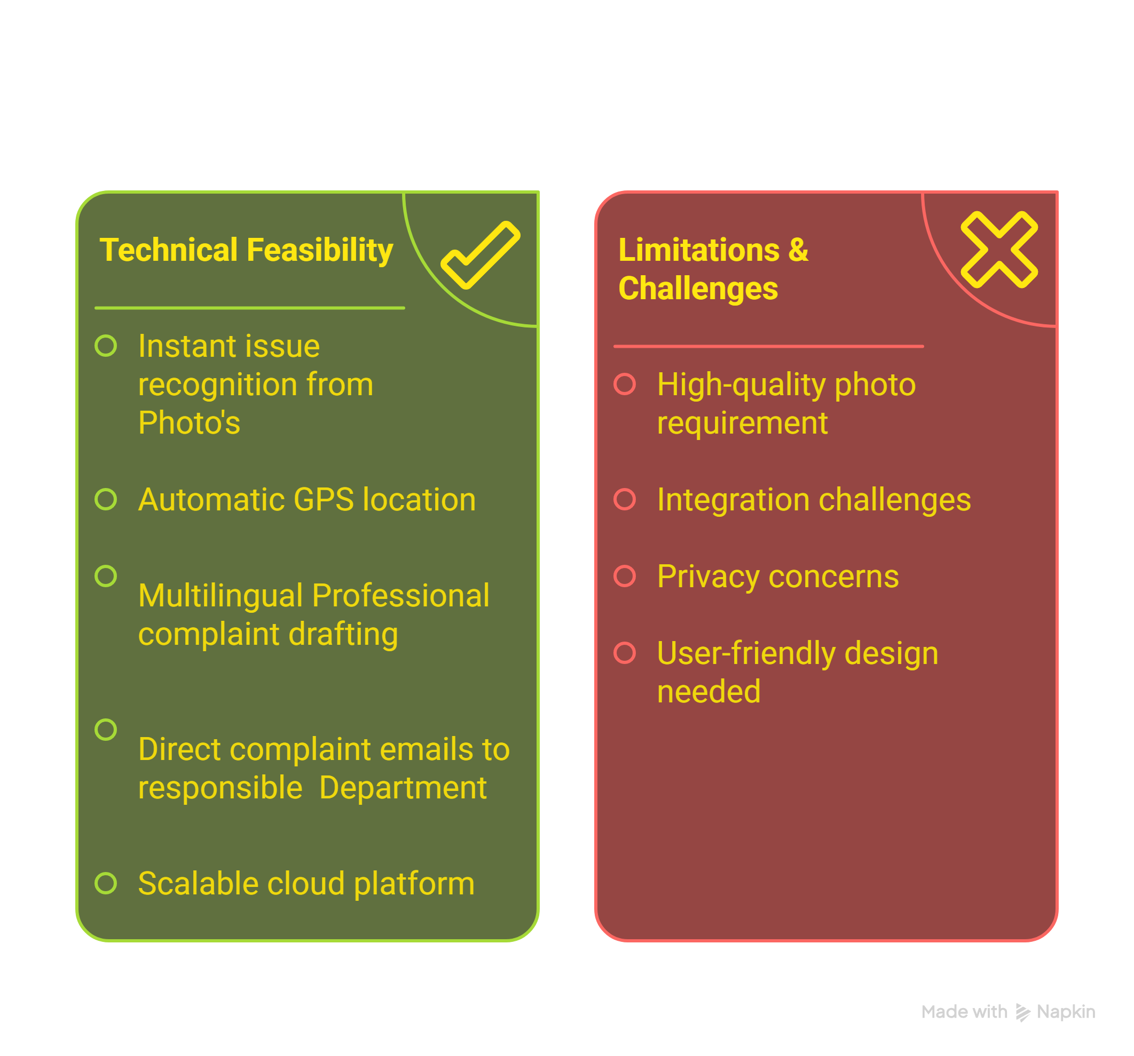
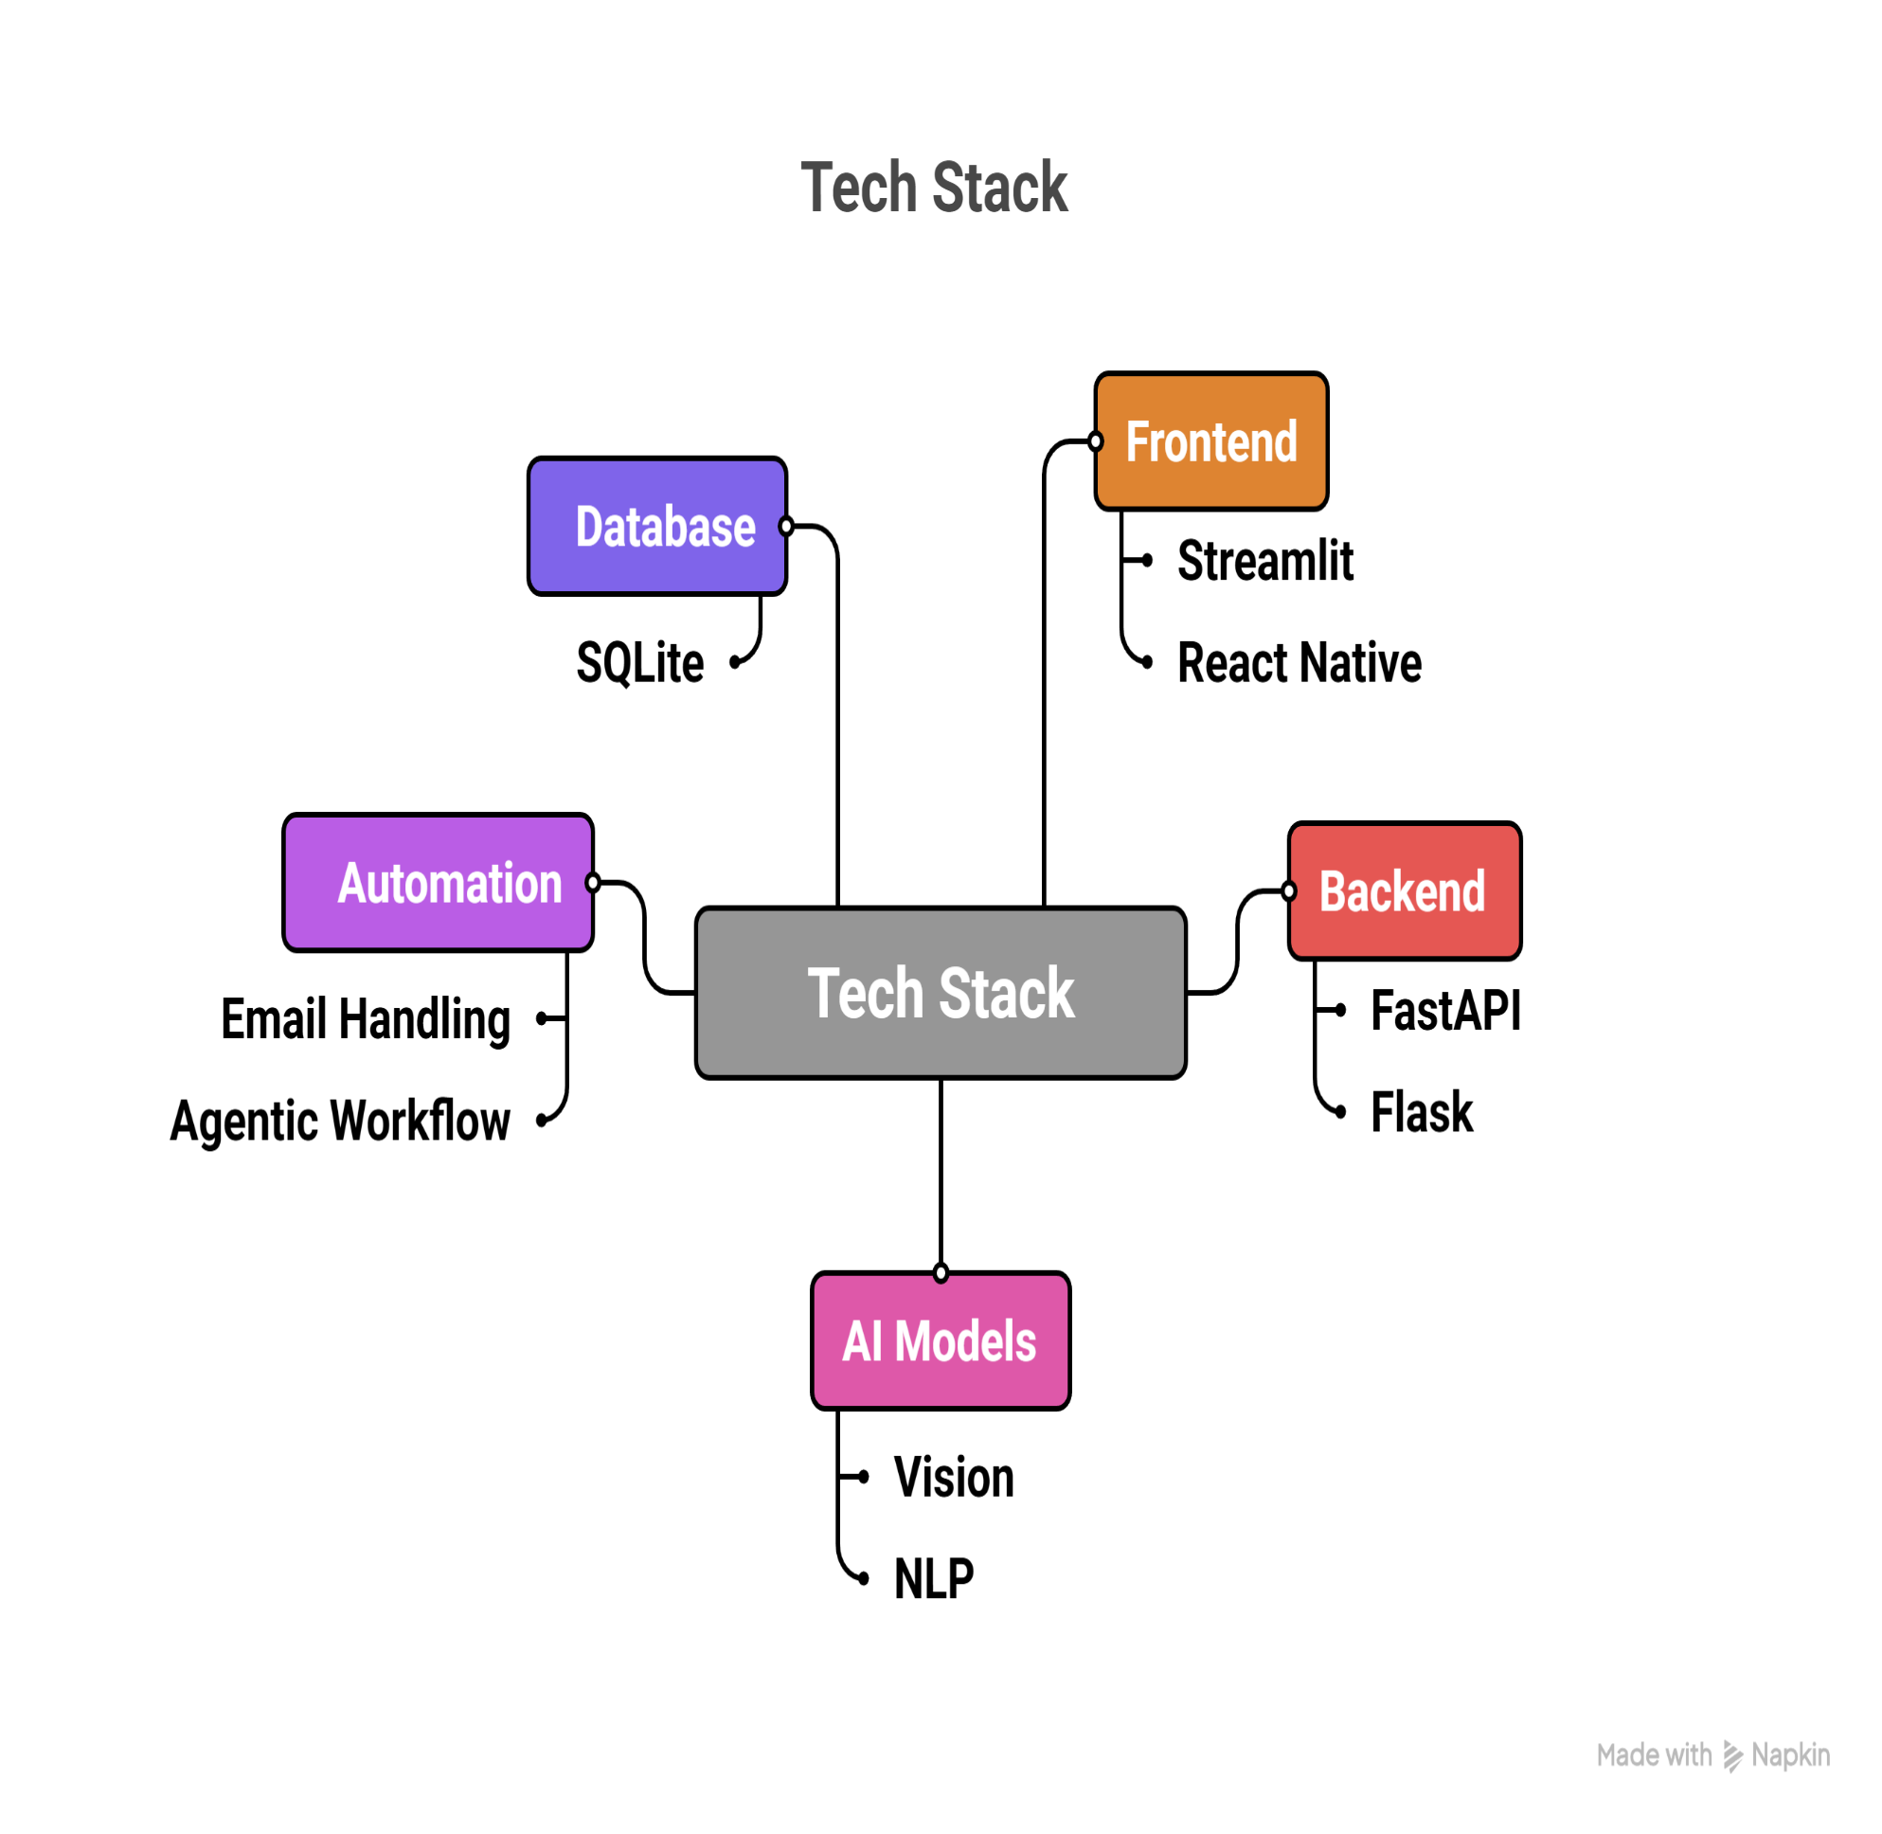

Innov8rs
Tech Stack and Feasibility

Slide 5
Innov8rs
Future Scope
Reporting a problem will soon be as easy as sending a photo on WhatsApp or speaking into your phone in your own local language.
Instead of just an email, your report will go directly into the Municipal Corporation’s computer system and become a real complaint with a tracking number.
Our service will expand beyond big cities so people in rural villages can also report local issues like a broken hand-pump to their Panchayat.
We will give city officials a live map that shows exactly where the most problems are located so they can easily decide which neighborhood needs help first.
Instead of just fixing existing problems the system will learn to predict future issues like warning the city about a drain that is likely to flood.

